Slide 1
Finance
Investment Banking in a Business Context

Slide 2
Module outcomes
After completing this module you will be able to:
Describe the types of markets that exist in the finance industry.
Describe the functions of the Front Office, the Middle Office and the Back Office.
Describe the types of derivatives that can be traded over the counter or on the exchange.

Slide 3
IB Business Context
Introduction to Finance
Big Picture
Traded Instruments
Investment Bank Organisation

Slide 4

The Big Picture
The Markets
Capital markets
Money markets
Commodity markets
Derivatives markets
Futures markets
Insurance markets
Foreign Exchange markets

Slide 5


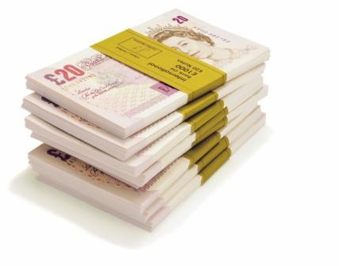
How do companies use the finance markets?
Companies tend to be borrowers from the markets for:
Expansion
Investing in new assets / equipment
Cash flow
Re-financing

Slide 6
How do individuals use the finance markets?
Many individuals are not aware that they are lenders! Almost everybody lends money in some ways:
Money in a savings account at a bank
Contributions to a pension or savings plan
Pay premiums to an insurance company policy (life, car, home etc)
Invest in government bonds
Invest in company shares

Slide 7

Capital Markets
Stock market:
    Provide financing through the issuance of shares or common stock, and enable the subsequent trading thereof.
    Bond market:
    Provide financing through the issuance of bonds, and enable the subsequent trading thereof.

Slide 8
Relative Advantages and Risks: Stock vs Bonds
 | Advantages | RISKS
Bonds | Contracted Interest Rate Senior Right in Bankruptcy | Market Risk Default Risk
Stock | Ownership Rights – Vote Dividends (Potential) Capital Gains (Potential) | Market Risk Default Risk – Bankruptcy Dividend not guaranteed

Slide 9

Money Markets
  Provide short-term debt financing and investment
  (12 months or less) via:
  Short mortgage and asset-backed securities
Treasury bills
  Commercial paper
  Bankers‘ acceptances
  Certificates of deposit

Slide 10

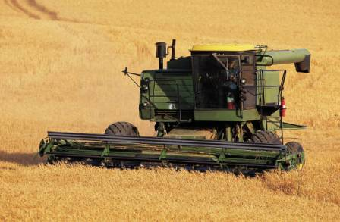
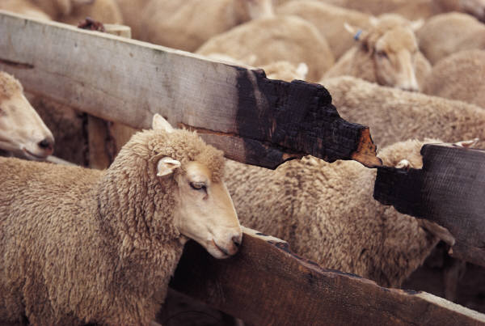

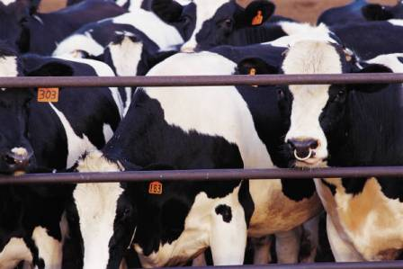
Commodity Markets
Energy (oil, gas)
Metals (iron, copper, gold, silver, platinum)
Agriculture (orange juice, wheat, oats)
Livestock and meat (live cattle, pork bellies)
Other (rubber, wool)

Slide 11
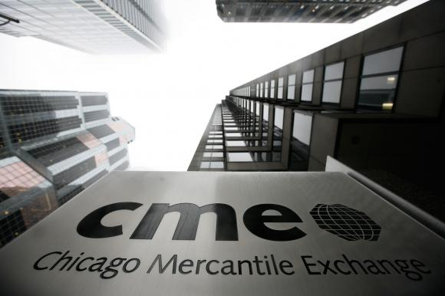

Derivatives Market
  Provide instruments for the management of financial risk. The market can be divided into two:
  Exchange-traded derivatives
  Over-the-counter derivatives (OTC)

Slide 12


Instrument Trading Methods
Exchange-Traded (XT) trading
Standarised terms
Commonly traded entities
  Cash securities (stocks, bonds)
  Indices
  XT derivatives
Exchange Guarantees trades
  Lower risk, higher prices
Over-the-counter (OTC) trading
Flexible terms
Tailor-made (or customised)) products
Privately negotiated
  Higher risk

Slide 13





Underlying Instrument Asset Class Examples
Equities
  AT&T stock
Rates
  Risk-free 10 year government bond, 5% annual coupon
Indices
  Portfolio products built to track market index
    S&P500 or FTSE100
Foreign Exchange (FX)
  Exchange Swiss Franc (SwF) for US Dollar ($)
Commodities
  Gold, Silver, Platinum, Oil etc
Synthetics
  Products synthesised to manage credit exposure risk
    Credit Default Swap (CDS)

Slide 14
Futures markets
Provide standardised forward contracts for trading products at some future date (also forward market)
The contract details the asset to be bought or sold, how, when, where and in what quantity it is to be delivered, the currency in which the contract will trade, minimum tick value, and the last trading day and expiry or delivery month
Speculators on futures price fluctuations who do not intend to make or take ultimate delivery must take care to "zero their positions" prior to the contract's expiry!
Contract will be settled, either by physical delivery or by a cash settlement
The contracts ultimately are not between the original buyer and the original seller, but between the holders at expiry and the exchange

Slide 15

Insurance markets
Facilitate the redistribution of various risks via ‘reassurance’ of:
Life
Marine
Automobile
Health
Home
Business
Professional Indemnity
Employer risks etc.

Slide 16




Foreign exchange markets (FX)
Assists international trade and investment:
Allowing businesses to convert one currency to another
Supports speculation another currency
Facilitates the ‘carry’ trade

Slide 17
Major Organisation Levels
  Front Office
    Generates revenue
  Operations
    Middle Office (Controls business)
    Back Office (Executes accounting and settlement)
  Technology supports all business divisions
Front Office
Dealing Room
Technology
O
p
e
r
a
t
i
o
n
s
Middle Office
Business Supporting Activities and Control
O
p
e
r
a
t
i
o
n
s
Business Applications
Technical Support
Back Office
Day-to-Day Business Settlement Functions

Slide 18




Trade Negotiation Actors – Front Office
Clients
  Buyers of bank instruments
    Private clients
    Companies
    Financial institutions
Front Office staff
  Sales Person
    Handle client relations
  Marketer
    Maintain up-to-date market knowledge
    Sell new IB products
    Develop trade models
  Trader
    Buy and sell IB products
    Risk management of position

Slide 19
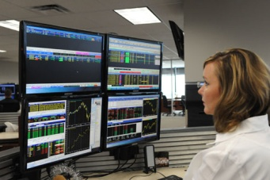



Trade Capture and Risk – Middle Office
Trader assistants
  Assist
    Front Office traders
Credit officers
  Ensure
    Trading within limits
Risk analysis
  Analyse
    Trading patterns
    Risk policy compliance
Profit & Loss
  Measure of financial gain
    Or otherwise!
  For particular period

Slide 20


Account and Settlement – Back Office
Accounting
Settlement

Slide 21
IB Business Context
Brief Introduction to Systems
Traded Instruments
What Is an Instrument?
Main Derivative Products
Instrument Classes

Slide 22






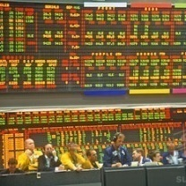


Derivative Types
Futures
Forwards
Options
Swaps

Slide 23
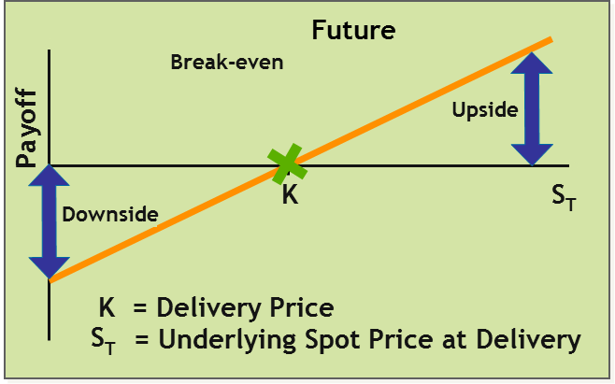
Future Derivatives
Contract compels investor to buy or sell
  Underlying asset
  At pre-agreed delivery price
  On delivery date
Negotiation via futures exchange
  Margin contract
    Profit and loss settled daily
    Via margin calls

Slide 24
Forward Derivatives
Contract similar to future, with more flexibility
  Parties seek each other out or employ
  Investment Bank intermediary
  Contracts custom-made, without margin calls
Payoffs from forwards
Long position (buying)
Short position (selling)
Breakeven
Breakeven
f
f
f
f
o
o
y
y
a
K
S
a
K
S
P
T
P
T
K = Delivery Price
K = Delivery Price
S
= Underlying Spot Price at Delivery
S
= Underlying Spot Price at Delivery
T
T
Notes:
Forward contracts on foreign exchange (currencies) are very popular. For instance, you may agree to buy $2 million dollars for £1 million pounds, in six months time. Whatever happens in the foreign exchange markets, you must hand over £1m in six months, for which you will receive $2m, regardless of what the exchange rates happen to be at the time. The advantage to this is that you know in advance what you need to hand over and what you’ll get. The disadvantage is that you don’t know what the exchange rates will be in six months. You might be a big winner, or a big loser, depending how it goes.
Taking a short position means agreeing to sell the underlying or “being on the Call side of the contract”. Taking a long position means agreeing to buy the underlying or “being on the Put side”.
Today’s exchange rate could be $2 = £1
In six months time, it could be $3 = £1. If it is, in the deal above, the long position buying the dollars will lose $1 million dollars. The short position selling the dollars will gain $1 million dollars.
Alternatively, in six months time, it could be $1 = £1. if so, the long position buying the dollars will gain $1 million dollars, and the short position selling the dollars will lose $1 million dollars.
Alternatively, in six months time, it could also be $2 = £1, or the ‘K’ delivery price. In this case, neither the long or short position loses anything.
Obviously, there could be any range of other future positions, from $1,000,000 = £1 through to
$1 = £1,000,000. You makes your bets and you takes your chances!

Slide 25
Call & Put Option Derivatives
Option contracts
  Call option
    Holder may buy asset at pre-agreed price at future date
  Put option
    Holder may sell asset at pre-agreed price at future date
Option attributes
  Underlying
  Premium
  Strike
  Expiry date
  Spot price
    OTM*
    ATM
    ITM
Call Option
K = Strike Price
S
T
= Underlying Asset Price at Expiry
Break-even
Return
Premium
K
S
T
ITM
OTM
ATM

Slide 26



Option Types
Exercise style
  European option
    Exercise at expiry only
  Multi-European (or ‘Bermudan’/’Mid-Atlantic’) option
    Exercise at pre-agreed date windows
  American option
    Exercise at any time
American
Option
European
Option
M-E/Bermudan
Option
M-E/Bermudan
Option
M-E/Bermudan
Option
M-E/Bermudan
Option
Time
Start Date
Expiry Date

Slide 27
Swap Derivatives
Comparative advantage income scenario
  Party A have floating, require fixed rate
  Party B have fixed rate, require floating
OTC fixed-to-floating interest rate swap contract
  Exchange of two periodic legs* calculated
  over notional amount
e
t
a
R
t
s
e
r
LIBOR
e
t
n
Party B
I
+50bps
Time
e
t
a
R
t
s
e
Fixed Rate
Party A
r
e
t
n
I
of 3%
Time
* A series of periodic cash flows on one side of the swap are known as a ‘leg’

Slide 28
Swap Cash Flows
Swaps
Two legs of swap, nominal $100 million
Party A, Leg 1 - LIBOR +50bps
interest payments
$100m
$100m
$100m
Party B, Leg 2 – Fixed 3%
interest payments
$100m
Both legs combine to remove nominals
LIBOR +50bps
O
O
Start & End point
nominal flows cancel
out to leave just
interest payments
O
O
Fixed 3%

Slide 29
Swap Cash Flows
(continued)
Swaps
Interest payments cancel out to leave relative cash flows
Nominal $100m - Periodic Swap Payment | 1 | 2 | 3 | 4 | 5
LIBOR +50bps | 3.5% | 3.0% | 4.5% | 7.0% | 2.5%
Fixed | 3.0% | 3.0% | 3.0% | 3.0% | 3.0%
Gross Payment From Party A to Party B | $3.5m | $3.0m | $4.5m | $7.0m | $2.5m
Gross Payment From Party B to Party A | $3.0m | $3.0m | $3.0m | $3.0m | $3.0m
Net Payment From Party A to Party B | $0.5m | $0.0m | $1.5m | $4.0m | -$0.5m
$4.0m
$3.5m
Note, no
cash changes
hands in Period 2
$3.0m
$2.5m
Net Payment
From Party A
To Party B
$2.0m
$1.5m
$1.0m
$0.5m
$0.0m
-$0.5m
1
2
3
4
5

Slide 30
IB Business Context
Brief Introduction to Systems
Traded Instruments
What Is an Instrument?
Main Derivative Products
Instrument Classes

Slide 31
Instrument Classes
Vanillas
  High volume liquid ‘plain vanilla’ products
    Standardised
      Terms, expirations, and strike prices
    For example
      Credit Default Swaps (CDS)
Exotics
  Customised derivatives
    For example
      Barrier
      options
Hybrids
  Cross-asset customised derivatives
    For example
      Collateralised Debt Obligation (CDO)

Slide 32
Credit Default Swap
Vanillas
Provides protection for owners of credit instruments
Allows investors exposure to fixed income assets
without owning them
Bond holder effectively ‘insures’ against issuer defaulting
Reference
Entity
Bonds
Full restitution in event of default
Protection
Buyer
Protection
Seller
Vanilla!
Periodic Fees
Credit Risk Transfer

Slide 33
Barrier Option
Exotics
Underlying price level activates or inactivates option
Activation/inactivation
  Up or down
    Whether underlying price initially above or below barrier
  Knock-in or knock-out
    Whether contract initially activated or not
Option comes into play (Knock In)
Exotic!
Price
or
Option ceases to exist (Knock Out)
Barrier
Time
Start
End
Date
Date

Slide 34
Collateralised Debt Obligation (CDO)
Hybrids
Provides protection for owners of credit portfolios
  Bonds/Loans – generates cash flow (Cash CDO)
  CDSs/TRSs – no cash flow (Synthetic CDO)
Allows investors exposure to fixed income assets
without owning them
Hybrid!
Increasing
Risk
CDS Portfolio
Tranches
Purchase of
CDO Notes
Senior
Special
Purpose
Vehicle
Regular
Premium
Mezzanine
Coupons on
CDO Notes
and premium
Equity
Proceeds of CDO Notes
Coupon Payments
Protection
Sellers
Protection
Buyer
Collateral
Credit Risk Transfer

Slide 35


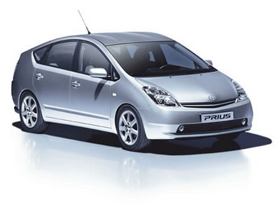
Instrument Classes
Vanillas
  High volume liquid ‘plain vanilla’ products
    Standardised
      Terms, expirations, and strike prices
    For example
      Credit Default Swaps (CDS)
Exotics
  Customised derivatives
    For example
      Barrier
      options
Hybrids
  Cross-asset customised derivatives
    For example
      Collateralised Debt Obligation (CDO)

Slide 36
Module outcomes
After completing this module you will be able to:
Describe the types of markets that exist in the finance industry.
Describe the functions of the Front Office, the Middle Office and the Back Office.
Describe the types of derivatives that can be traded over the counter or on the exchange.

